Slide 1

Module 3 Project Executive Summary
By: Darius Fuller
Part-time cohort 10/7/19

Slide 2
Target(s)
Query the database to retrieve the necessary data to do a statistical analysis.
Arrange the data in a useful manner using Python.
Use hypothesis testing to verify any differences among the data.
Find useful information to the company per the results

Slide 3
Scope/Database
Microsoft Northwind SQL Database
Contains sales and product data for a fictional company
Included:
General employee info (personal, location, clients)
Product info (prices, suppliers, categories)
Order info (prices, shipping, salesperson)
Customer info (personal, location, orders)
Total of 13 tables!

Slide 4
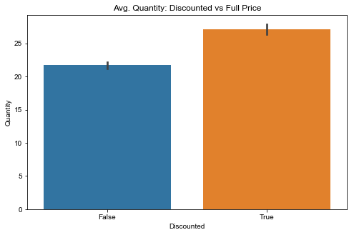
Questions Tested (1)
Does discount amount have a significant effect on the quantity of a product in an order? If so, at what level(s)?
Our test showed that with 95% confidence, discounting an order does have an affect on how much is ordered in total.
Positively too!
The levels: 5%, 15%, 20%, 25%

Slide 5
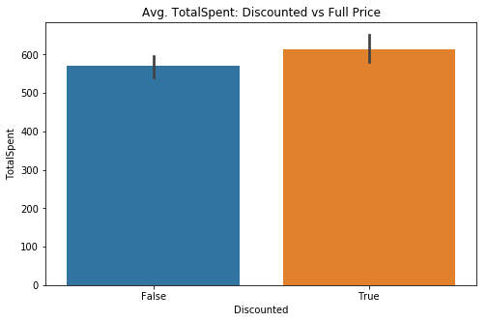
Questions Tested (2)
Does discount amount have a statistically significant effect on the total amount spent in an order? If so, at what levels?
Our test showed that with 95% confidence, discounting an order does not have an affect on how much is spent in total.

Slide 6
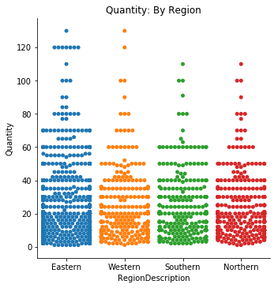
Questions Tested (3)
Does the region in which a product is sold have a significant effect on the quantity of a product in an order? If so, at what region buys the most?
Our test showed that with 95% confidence, the purchasing region does not have an affect on how much is ordered in total.
Inter-regionally our test found the same result.

Slide 7
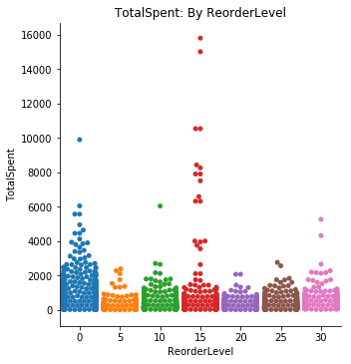
Questions Tested (4)
Does whether the company always keeps a product in stock have any significant effect on the total amount spent in an order? If so, is there any optimal level?
Our test showed that with 95% confidence, always keeping an item in stock does have an affect on how much is spent in total on an order.
Items reordered at 0 and 15 units left proved to be significant.

Slide 8
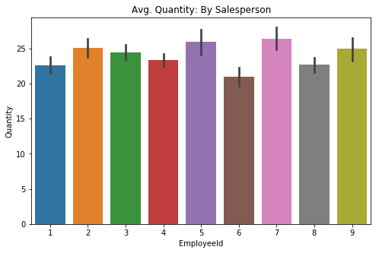
Questions Tested (5a)
Does the sales representative making the deal have a significant effect on the quantity of product ordered? What about total spent?
Our test showed that with 95% confidence, the corresponding sales rep does not influence how much is ordered in total.

Slide 9
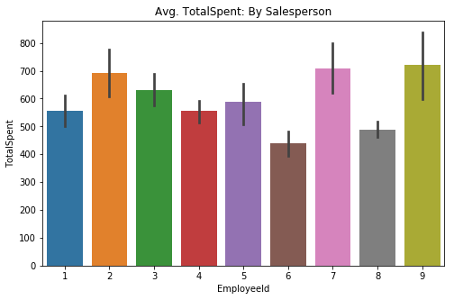
Questions Tested (5b)
Does the sales representative making the deal have a significant effect on the quantity of product ordered? What about total spent?
Our test showed that with 95% confidence, the corresponding sales rep does influence how much is spent in total.

Slide 10

Conclusions
Q1: Given the levels we found, the company’s policy surrounding discounts is allowing them to send out larger orders on average.
Q2: Considering the discount itself, we cannot say that discounting orders has any effect on revenue generated.
Q3: The data was unable to pinpoint any region that orders a significantly different amount of product than others. No need to segment greatly.

Slide 11
Conclusions
Q4: There is something behind the revenue generated by products with a reorder level of 15 units and those without one. More analysis needed.
Q5: Reliably the data shows no significance for sales rep on quantity ordered. However, there is some significance with respect to revenue.

Slide 12
Future stuff
Q4: There is something behind the revenue generated by products with a reorder level of 15 units and those without one. More analysis needed.
Q5: Reliably the data shows no significance for sales rep on quantity ordered. However, there is some significance with respect to revenue.
Notes:
Express significance differently and add actionable steps

Slide 13

Thank You!

